Slide 1
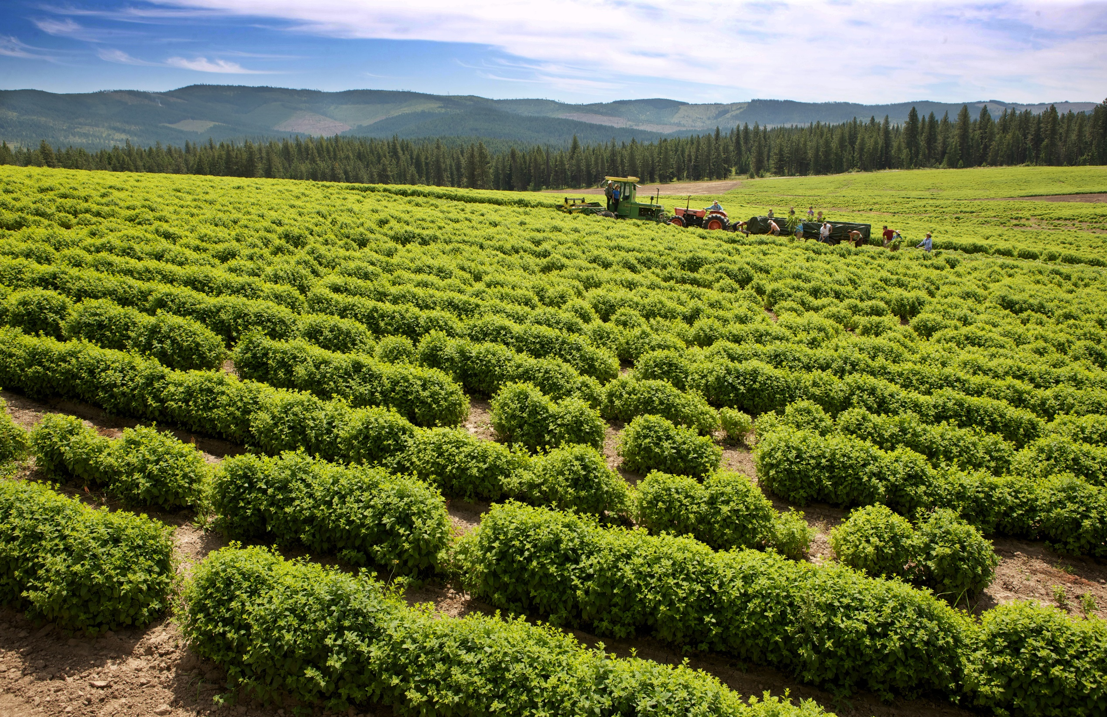
Statements in this presentation marked by a * have not been evaluated by the Food and Drug Administration. Products presented are not intended to diagnose, treat, cure, or prevent any disease.
Notes:
Hi, my name is _____, and I am an independent distributor of Young Living Essential Oils. Today we are going to learn about Young Living—our history, our values, and our company, as well as discover what essential oils are and how to use them and explore the oils that are in the Starter Kit.

Slide 2
MY YOUNG LIVING STORY
Insert your picture here.
Notes:
Everyone has their own story about how they started using Young Living products. Some people want to support their wellness and health, others want to support their family with a more natural approach, others may join to get free products, and someone else may join to support their family’s security and future with additional income. I joined Young Living because: [Share your story compliantly.]

Slide 3
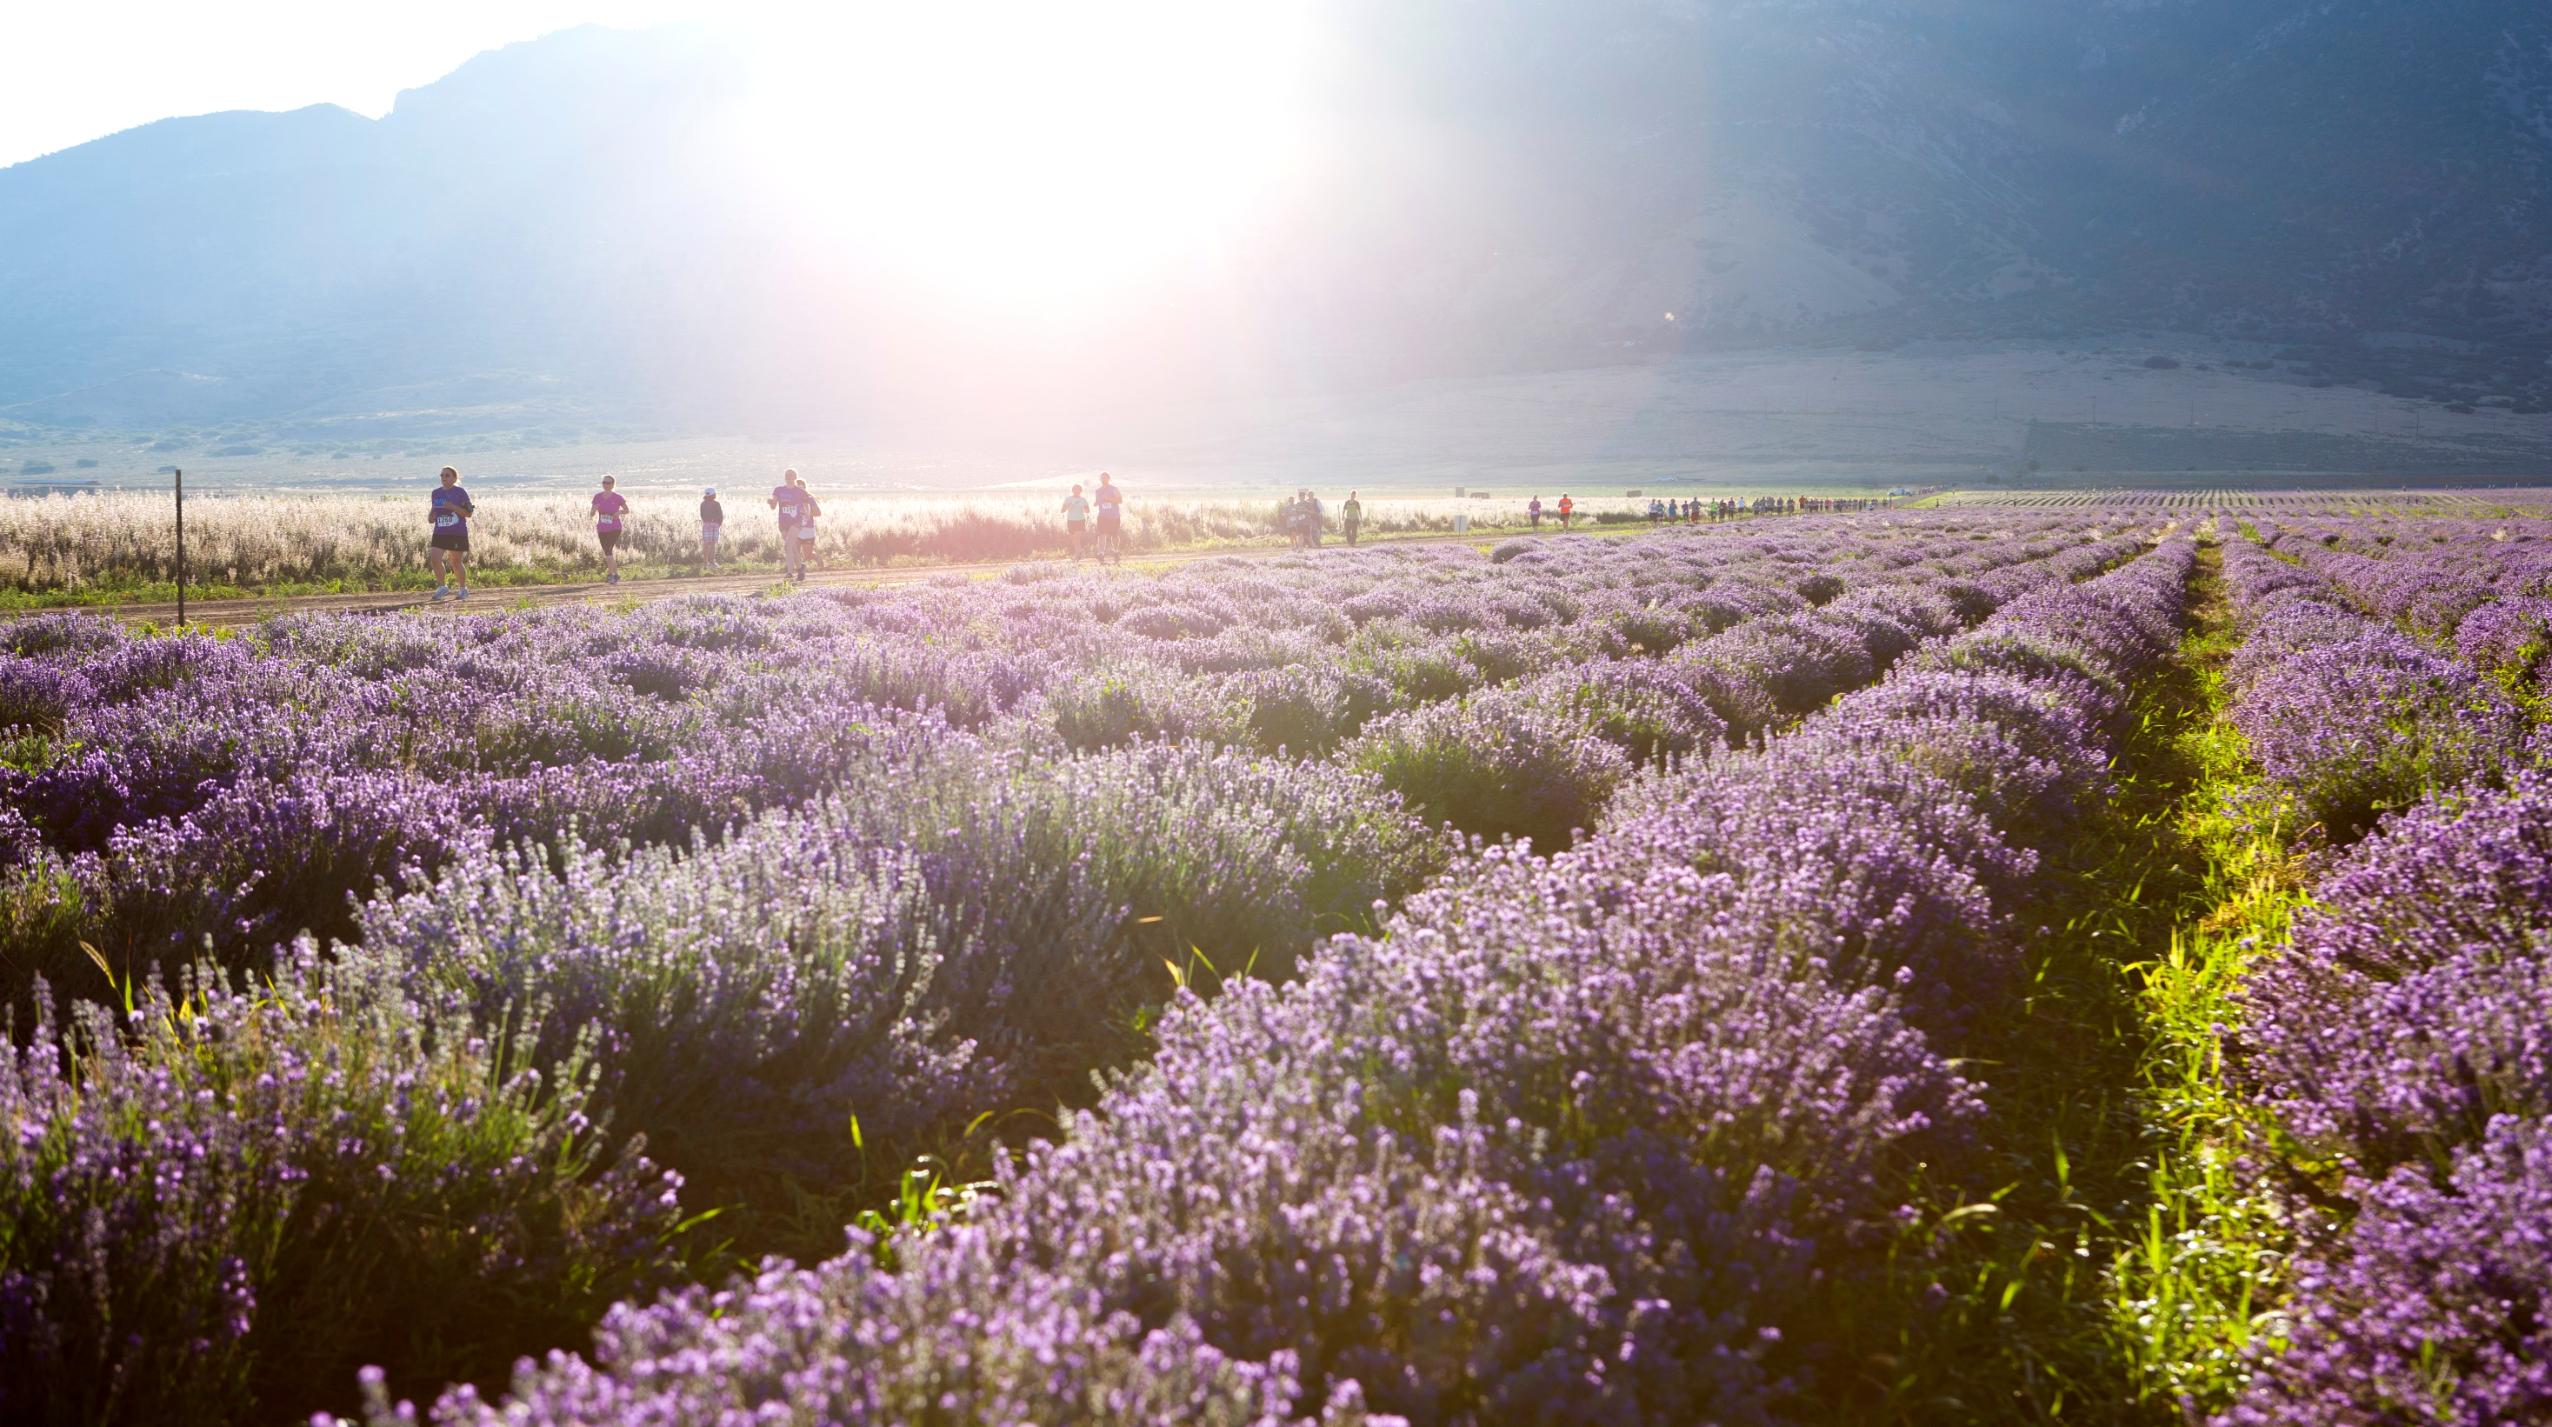
MISSION STATEMENT
We honor our stewardship to champion nature’s living energy, essential oils, by fostering a community of healing and discovery while inspiring individuals to
wellness, purpose, and abundance.
Notes:
No matter what your reason for joining Young Living, you can find greater wellness, purpose, and abundance. Young Living’s mission encompasses all of these aspects and signifies exactly what we are about. [Read mission statement.]
Young Living inspires wellness, purpose, and abundance by distilling nature’s greatest gifts into pure essential oils. With a commitment to plant purity and essential oil potency, Young Living continues to grow, inspiring millions of people to transform their lives.
The principles behind our mission statement have always been the top priority for Young Living Founder and CEO D. Gary Young. He won’t rest until his unique message and essential oil-infused products have been taken to every home in the world.

Slide 4
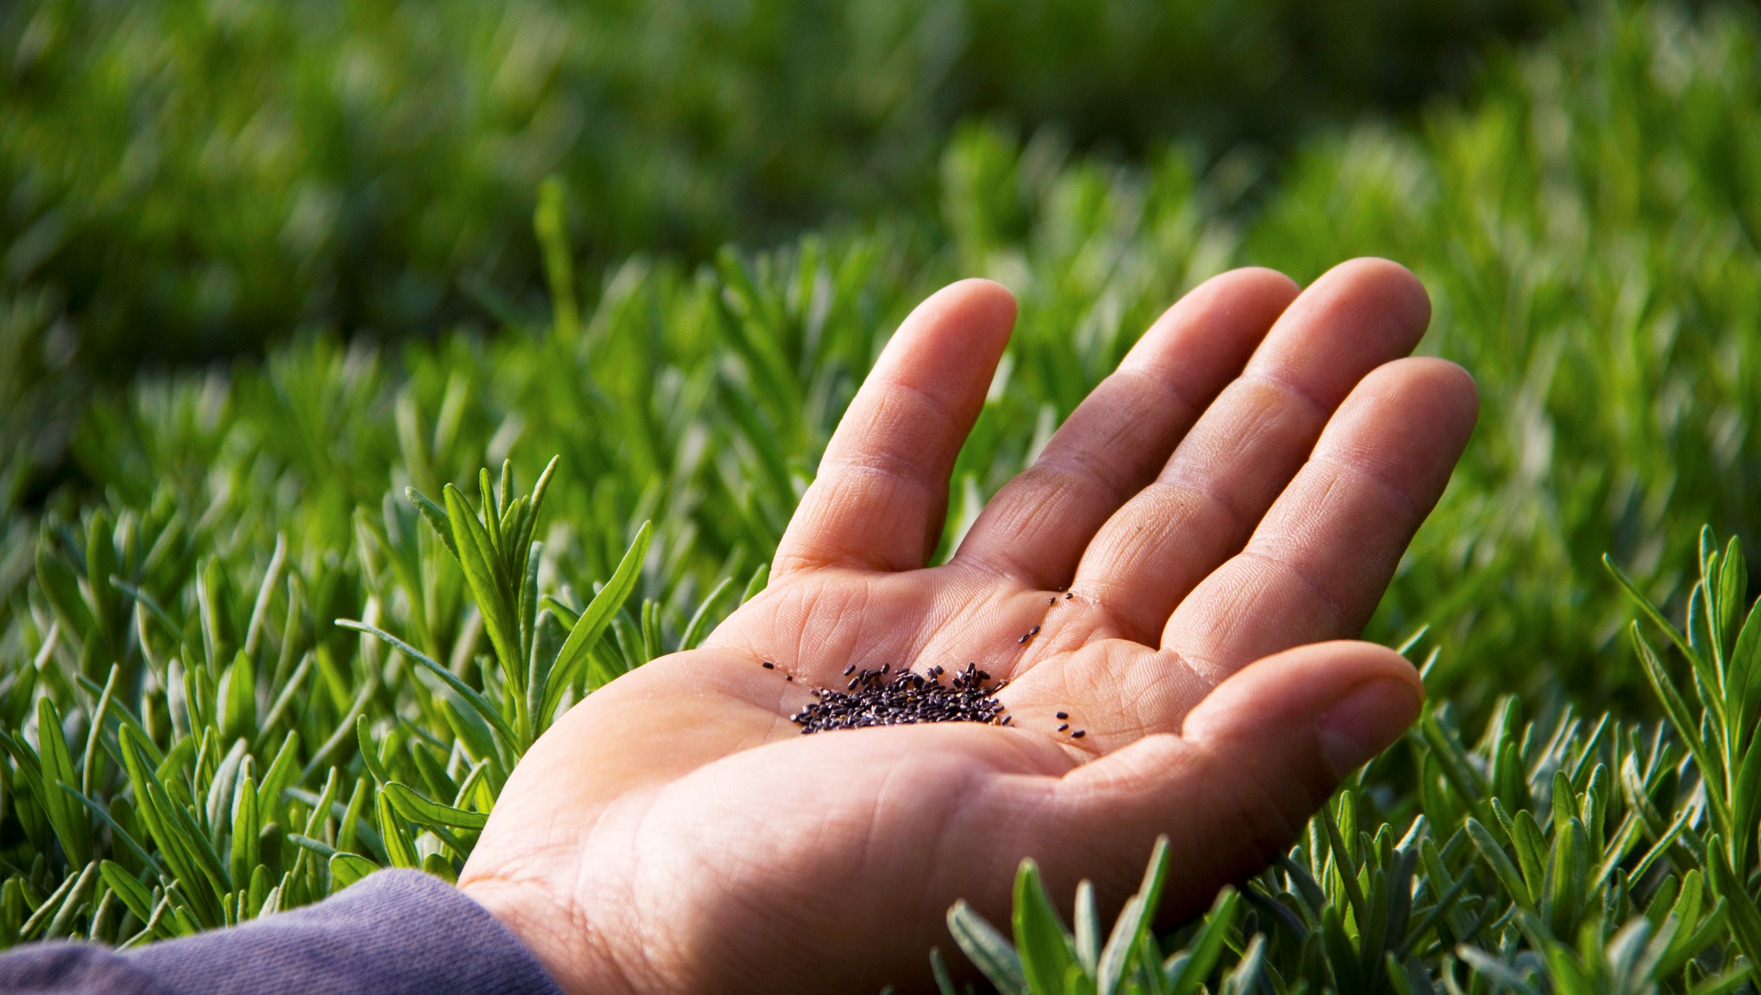
WELLNESS
PURPOSE
ABUNDANCE
Notes:
Imagine a life of optimal wellness, with clear purpose that adds meaning and abundance and allows you to support your family and give back to your community.
Come find wellness, purpose, abundance, and the freedom to live the life you choose.

Slide 5
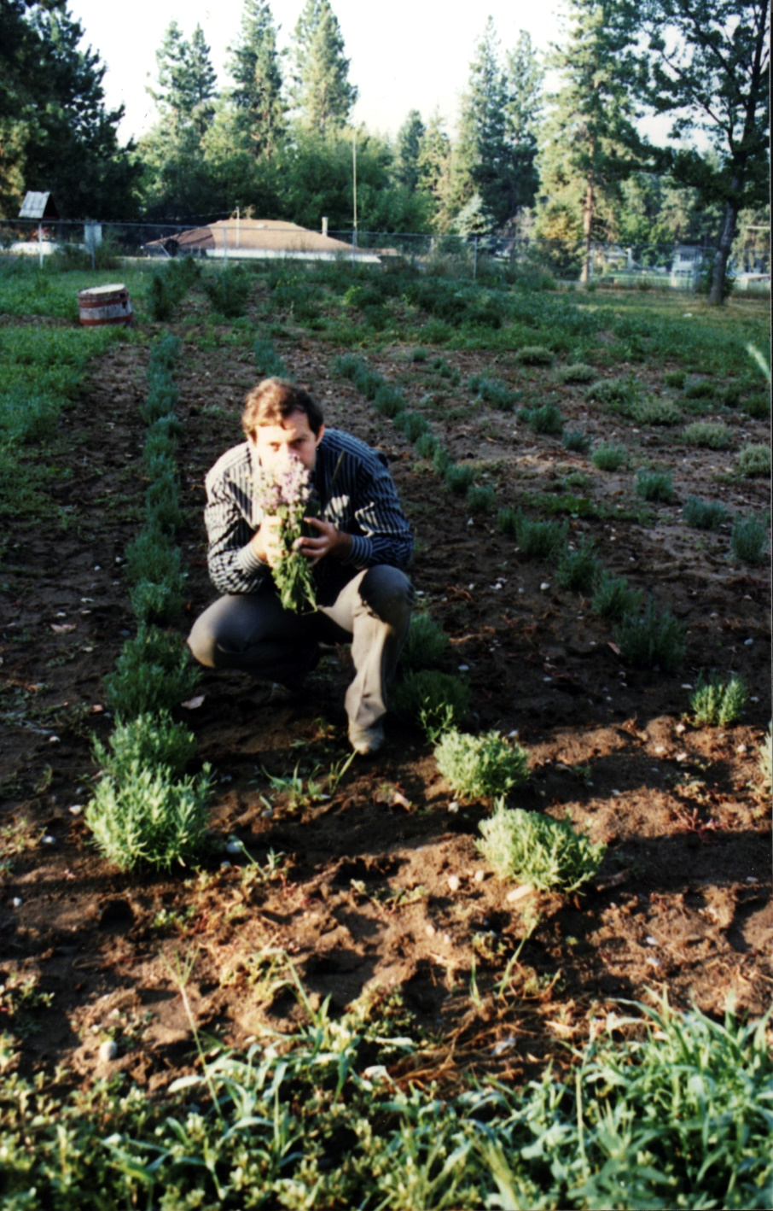
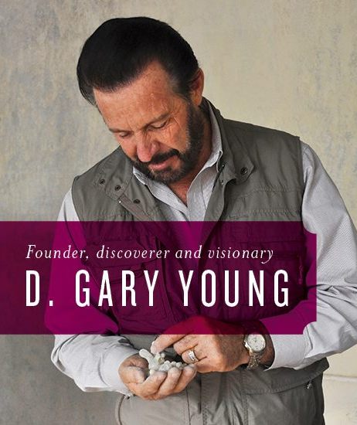
Notes:
Let’s talk about the beginnings of Young Living.
D. Gary Young is Young Living’s Founder. He grew up with humble beginnings in the rural town of Challis, Idaho, where he developed a profound appreciation for the power of nature. Having dedicated decades to traveling the world and researching the remarkable wellness benefits of these precious oils, Gary is one of the world’s foremost authorities on essential oils. Because of his experiences, Gary has never let up on his lifelong mission to share the highest quality essential oils in the world.
Gary Young's personal experiences have made him who he is today, expanded his empathetic nature, and left him with a true commitment to helping those in need. After helping himself recover from adversity, Gary knew he could help others as well. That has been his life's mission ever since: sharing his knowledge of and experience with essential oils and healthy living.

Slide 6
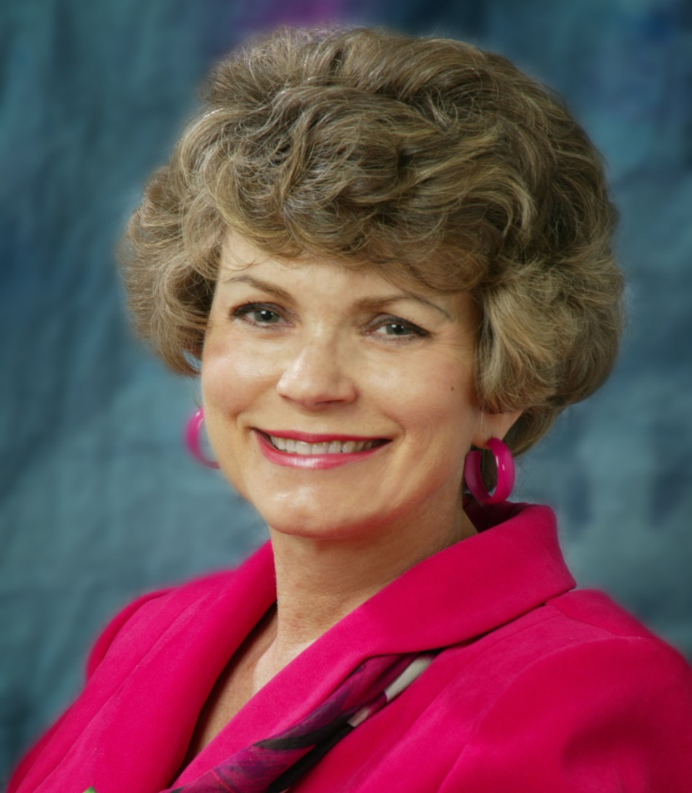
MARY YOUNG
CEO of Young Living
Introduced to relationship-based marketing in 1985 and soon thereafter built one of the company’s leading organizations
Has used her relationship-based business expertise to help make Young Living a global presence and the world leader in essential oils.
Her passion for authentic essential oils makes it possible for Young Living to share our pure products with families everywhere.
Notes:
Young Living is led by Mary Young as our CEO. She was introduced to direct selling in 1985, and quickly rose to the top ranks and managed a multimillion dollar organization. This experience was vital to bringing high quality essential oils to market. She has used her relationship-based business expertise to help make Young Living a global presence and the world leader in essential oils Now leads a company that inspires millions of people everywhere to experience nature's gifts of wellness, to create abundance as Young Living members, and to discover new opportunities for lifelong transformations.

Slide 7
1985 Gary is introduced to essential oils
1989 Gary plants his first lavender farm in Spokane, Washington
1994 Young Living Essential Oils is established
1999 Young Living opens Japan and Australia
2005 Young Living opens UK and purchases a fourth farm
2009 Young Living opens Mexico
2010 Young Living establishes an Omani distillery
2011 Young Living opens Ecuador and Singapore
2013 Young Living opens Canada, Germany, and Hong Kong
2014 Young Living opens Malaysia
Notes:
Young Living has grown from a tiny business into the world leader in essential oils. From Gary’s first introduction to essential oils in 1985, we have now expanded around the world, with farms, markets, shipping facilities, members, and offices across the globe. Here you will see a few examples of important points in Young Living’s history.

Slide 8
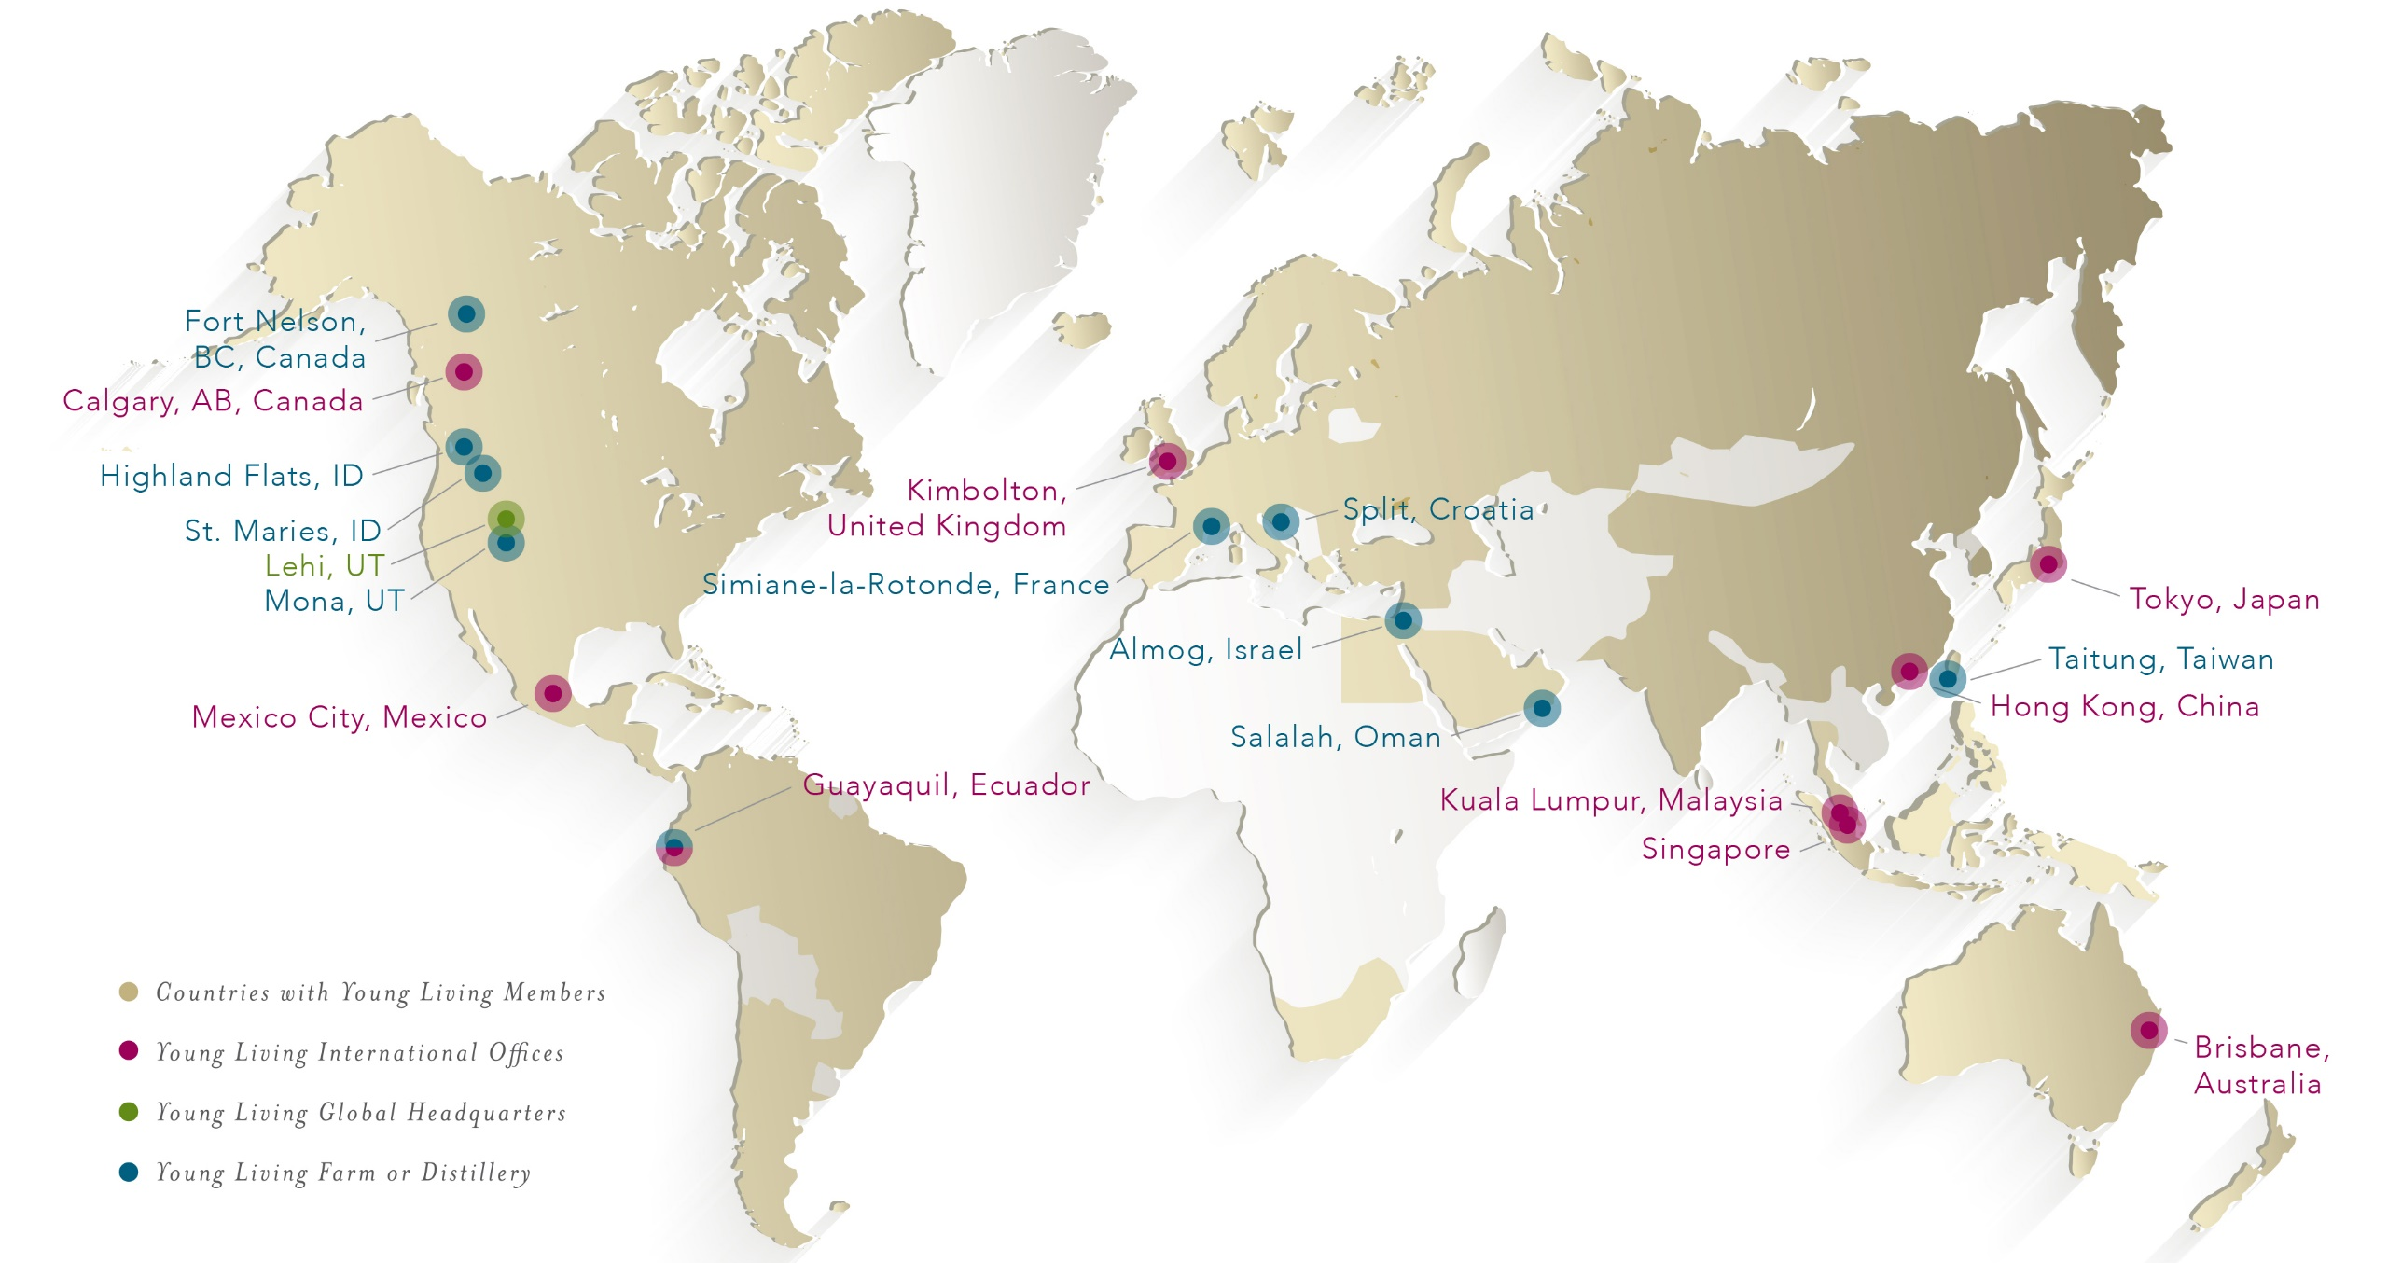
Notes:
I love this picture because it depicts Young Living’s global impact. Despite his extensive responsibilities as CEO, Gary Young is passionate about our farms and remains instrumental in overseeing our many global farms, where he directs the growth, harvest, and distillation processes of our high-quality essential oils.
It is amazing to see that even with so much growth around the world, Young Living remains dedicated to that powerful mission we discussed earlier.

Slide 9
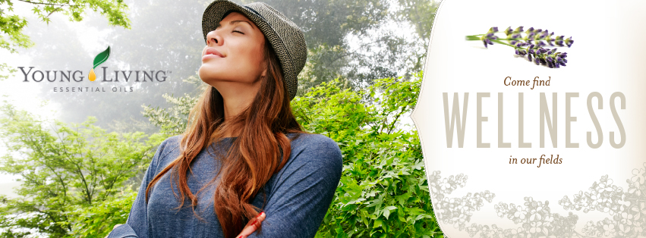
WELLNESS COMPANY
Notes:
First and foremost, we are a wellness company. We are committed to helping you live your healthiest life. True wellness starts from within, and Young Living offers an extensive array of nutrition products and essential oils to support wellness. In order to help you live a toxin-free lifestyle, Young Living offers personal care and household products to ensure that you and your family can benefit from naturally derived products for every part of your day.

Slide 10
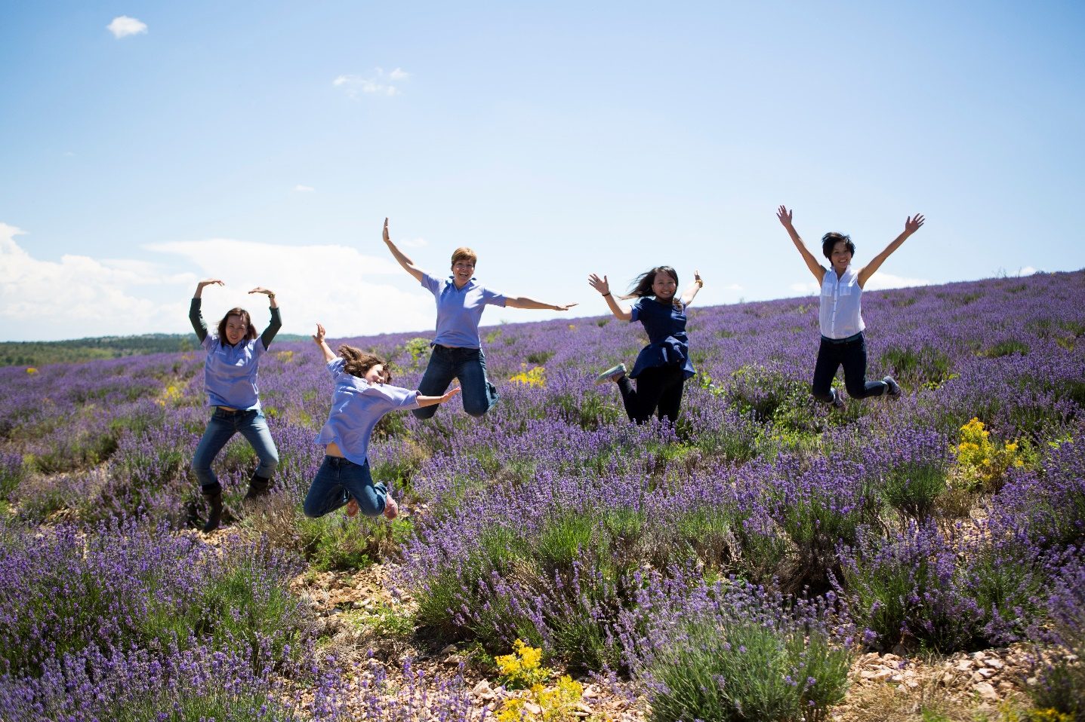
YOUR LIFE. YOUR HEALTH. BE EMPOWERED.
Notes:
With Young Living, you can support your own health and well-being. Are you ready to be empowered? [Wait for response.]

Slide 11
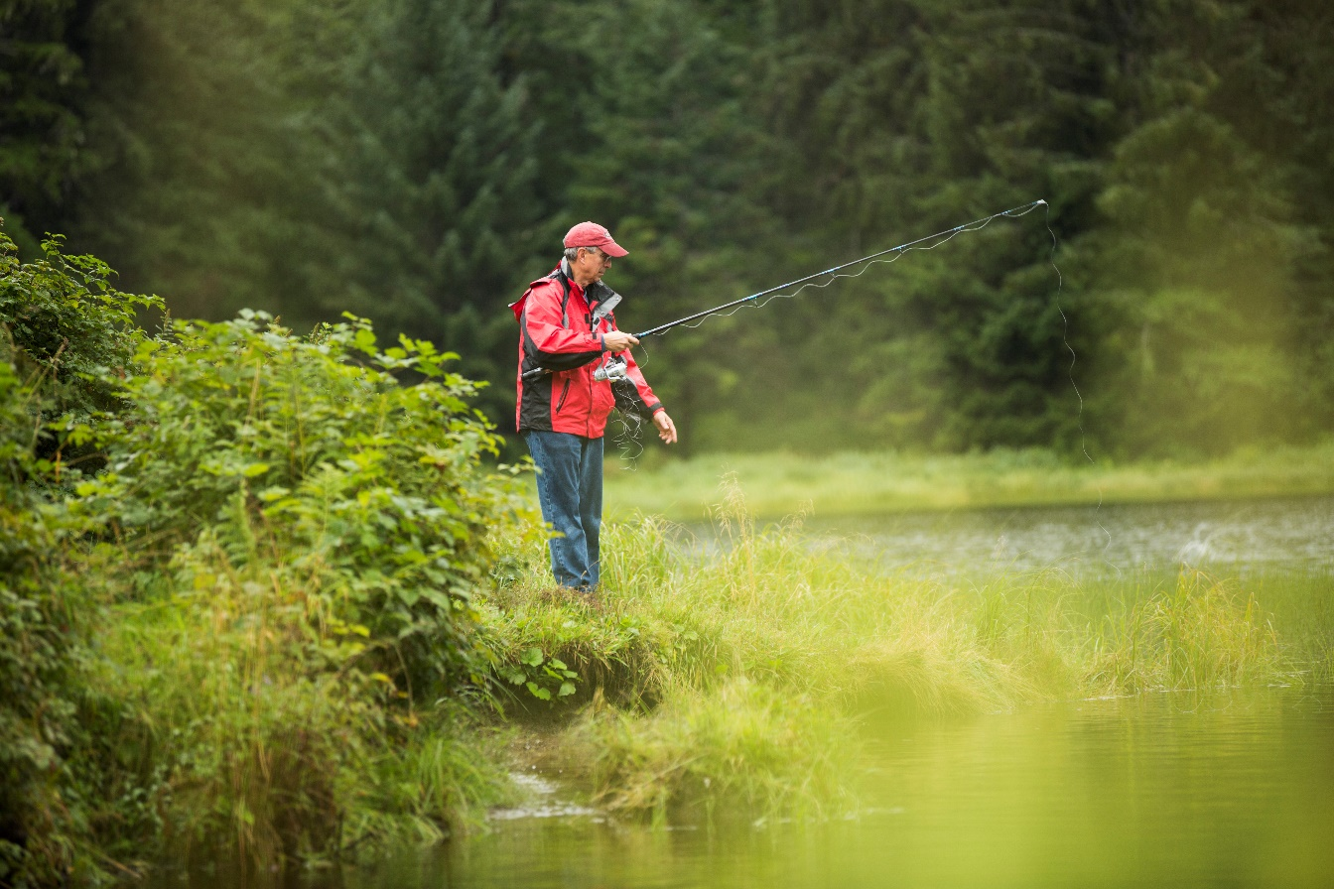
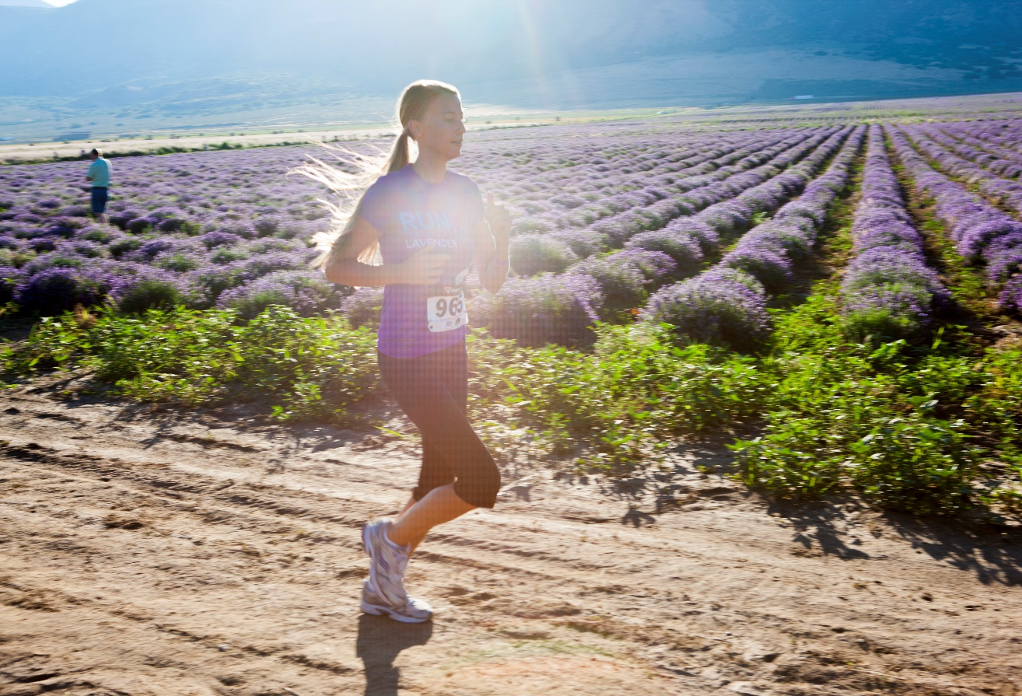
YOUNG LIVING LIFESTYLE
Notes:
By living the Young Living lifestyle, every aspect of your daily life can be enhanced and benefit from essential oils and essential oil-infused products.

Slide 12
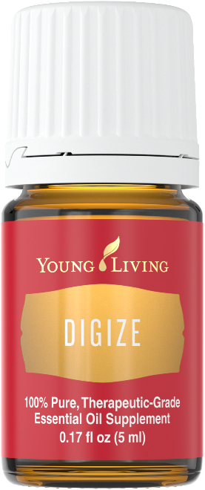
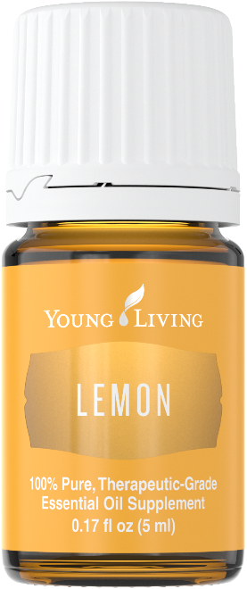
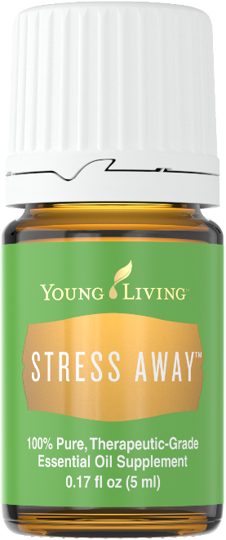
WHAT IS AN ESSENTIAL OIL?
A volatile substance derived from plants, containing the natural smell and characteristics of the plant
Extracted primarily through steam distillation
Potent, volatile, and versatile
Notes:
So what is an essential oil?
Essential oils are the aromatic liquids found within shrubs, flowers, trees, roots, bushes, resins, and seeds. Some people like to call essential oils “nature’s living energy” because they contain unique constituents that provide a host of benefits.
Most essential oils are extracted from plant sources using steam distillation and are highly concentrated, making them far more potent than dried botanicals.
Essential oils are volatile, which means that the scent of the oil rises quickly into the air.
They are also versatile, with a wide variety of uses. Some people use essential oils to enliven an environment, support different body systems, or just for their great scents. However you choose to use essential oils, chances are someone else has tried that same use in the past. If you still don’t know where to start, rest assured that each essential oil is labeled with instructions for use.

Slide 13
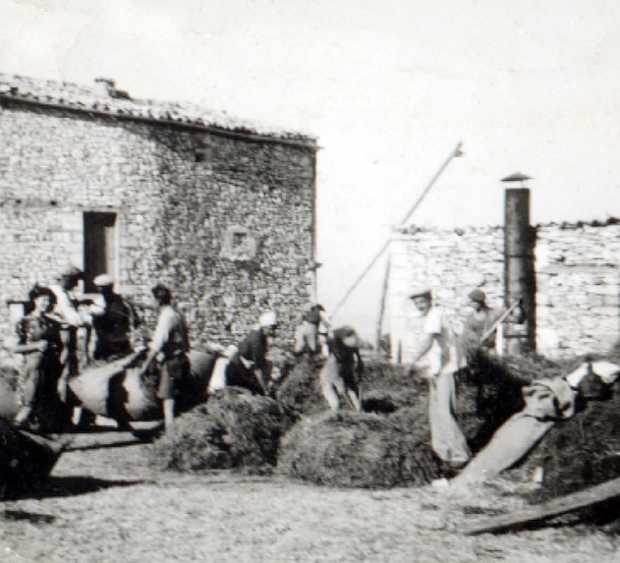
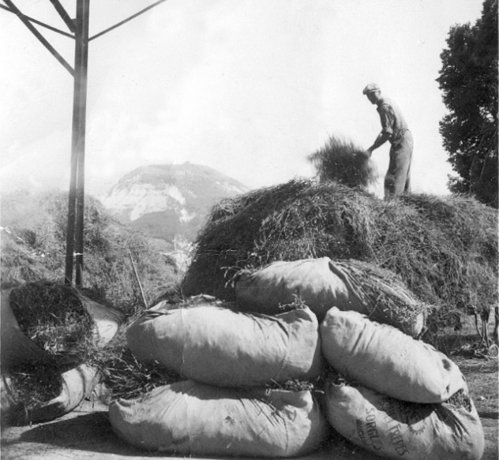
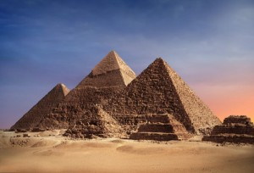
HISTORY
Notes:
Essential oils are nothing new. They have been used throughout history in many cultures for their health-supporting benefits. The Egyptians, Greeks, Romans, Europeans, and Chinese have used them for centuries for health, beauty, fragrance, and spiritual practices. There are also many references to essential oils in historical texts, which signifies their importance in history.

Slide 14
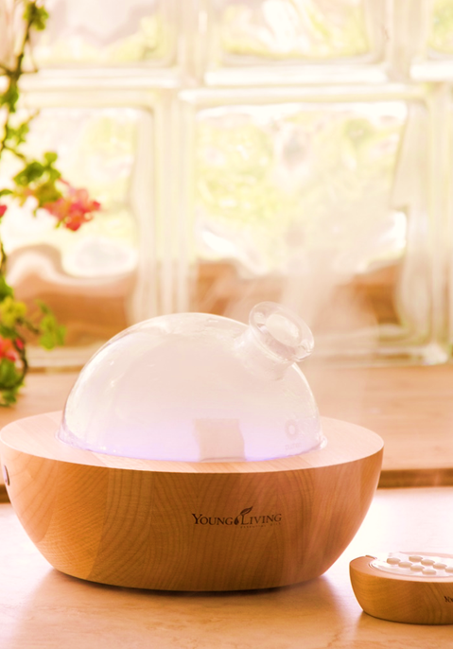
How do you use
ESSENTIAL OILS?
Notes:
Since everyone here is relatively new to essential oils, let’s talk about how they can be used. There are three ways to use essential oils. You can use some oils aromatically, some topically, and some can even be taken internally.

Slide 15
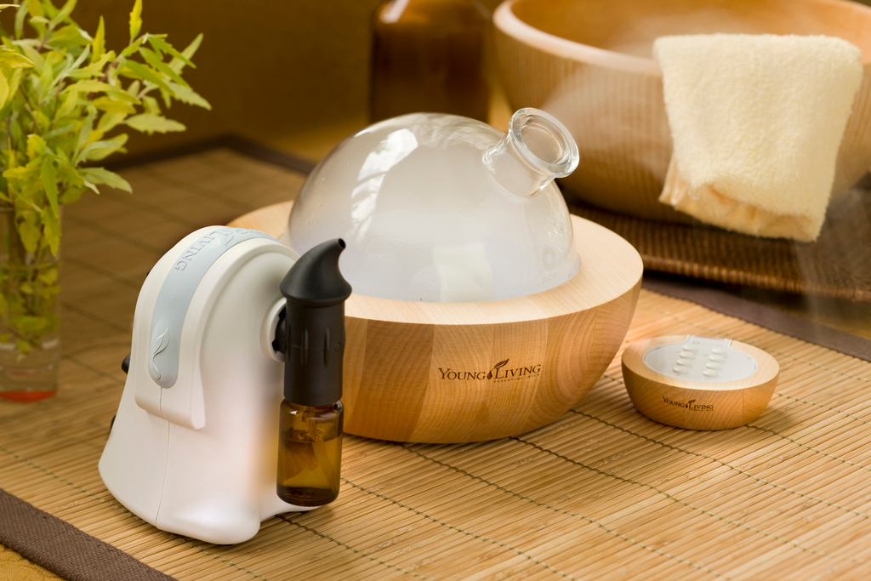
AROMATICALLY
Notes:
One of my favorite ways to use essential oils is aromatically. Many of us have had a time where a smell triggers a memory—freshly baked bread, pine needles, or spring flowers can easily take you back to positive times in your life. Essential oils are the same!
Let’s all use my favorite oil aromatically. I love ________ essential oil because it smells like___________. Using it is as easy as one, two, three:
Place a couple of drops in the palm of your hand.
Rub your hands together.
Cup your hands over your nose and mouth and inhale deeply.
Diffusion is another great way to use essential oils aromatically. By creating a fine aromatic mist, diffusers allow you to create a spa-like atmosphere and enjoy the benefits of essential oils in any environment. Young Living offers a wide variety of diffusers, and when you enroll as a new member, you will receive a diffuser in your Premium Starter Kit.

Slide 16
TOPICALLY
Notes:
Essential oils can also be applied to the skin. This is known as topical application. Topical application is a great way to support your skin because essential oils are easy to use and provide quick benefits. If you have never used essential oils, one great area of the body to apply them topically is to the feet.

Slide 17
INTERNALLY
Notes:
Some people choose to use essential oils internally by adding them to water or liquid, placing them in a capsule, or taking one of Young Living’s oil-infused products. Peppermint, for example, can help promote healthy bowel function and support overall digestion when taken internally.
[TIP: You may want to make a batch of NingXia Red punch by adding half NingXia Red and half club soda with a few drops of your favorite essential oil, such as Orange, Lemon, or Tangerine, and pass around samples.]

Slide 18
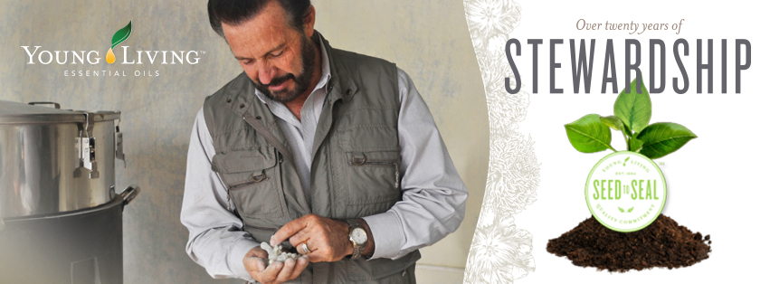
WORLD LEADER
Notes:
Of all the companies out there, why would you choose Young Living above all the others? Young Living is the world leader in essential oils. We believe that your family deserves to harvest the benefits of nature’s solutions every day, without compromise. Our commitment to purity and stewardship is embodied in a unique, proprietary process we call Seed to Seal. No other company can match what Young Living does to ensure the purity and potency of the highest quality essential oils on the market.

Slide 19
QUALITY FROM SEED TO SEAL
Notes:
Young Living’s commitment to quality starts with seeds. The seeds we use are selected for their ability to become botanicals with high levels of bioactive compounds.
We then grow the seeds using cultivation practices that are dedicated to responsible and sustainable growing and harvesting methods.
Next, we distill using a gentle, proprietary technique for steam extracting essential oils and preserving their precious constituents.
To guarantee consistent, verifiable quality, our oils are tested in Young Living’s own internal labs, as well as in third-party facilities.
Finally, each essential oil is carefully bottled and labeled using state-of-the-art equipment.

Slide 20
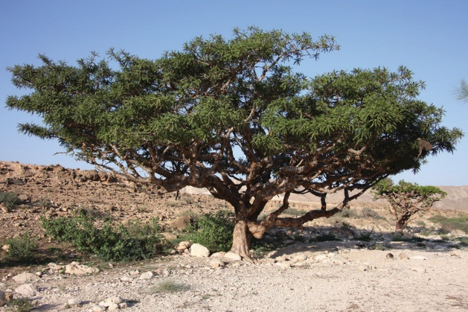
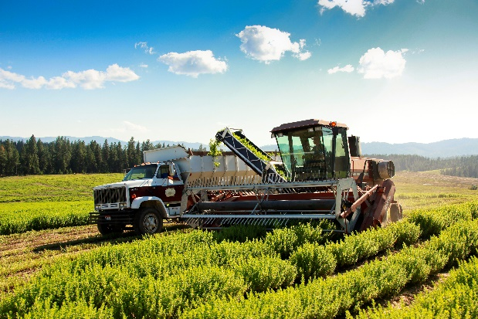
AROUND THE GLOBE
A look at our farms
Notes:
To ensure that Young Living is able to control every step of the Seed to Seal process, we own a number of farms and partner or co-op with many others around the world. Gary Young personally travels the globe to scout farms that offer ideal conditions for growing premium botanicals. This personal, direct involvement in the growing process is what allows us to ensure that each product delivers the purity and efficacy our members around the world expect.

Slide 21
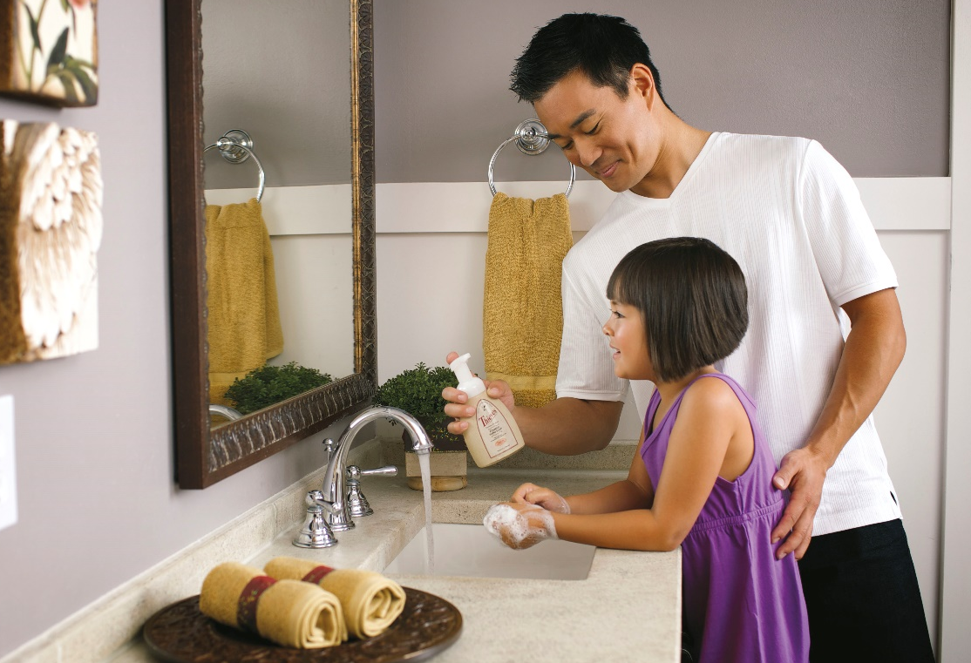
PROMISE TO FAMILIES
We believe that you and your family deserve products that are genuine, free of synthetic chemicals, and of unmatched purity. Seed to Seal® is both a promise to you and a reflection of our sense of global stewardship.
Notes:
Seed to Seal is not only our process of operations, but it is also our promise to your family. [READ SLIDE]
Through each step of our production process on both our own and our partner farms, we use the most exacting standards possible to make our products, your life, and the earth better. Only one company can make the Seed to Seal promise. Only Young Living.

Slide 22
PREMIUM STARTER KIT
Notes:
So how can you get started? One of the best ways is with the Premium Starter Kit. In the kit, you receive some of our most popular essential oils; a diffuser; sample packets of NingXia Red; and shareable materials, including sample packets, a roller ball, and more. It’s everything you need to discover the products for yourself and get immersed in the Young Living lifestyle. Let’s check out some of the oils in the Starter Kit.
[TIP: Have the oils ready to pass around the room and let people experience them firsthand.]

Slide 23
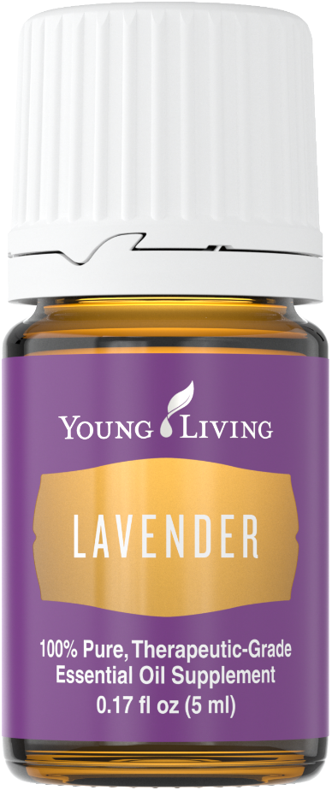
LAVENDER
Diffuse for a comforting and calming scent.
Unwind by adding a few drops to a nighttime bath.
Diffuse for a fresh, clean scent and to eliminate odors.
May complement some of your favorite shampoos, lotions, or skin care products.
Notes:
The first oil is Lavender. [READ SLIDE]

Slide 24
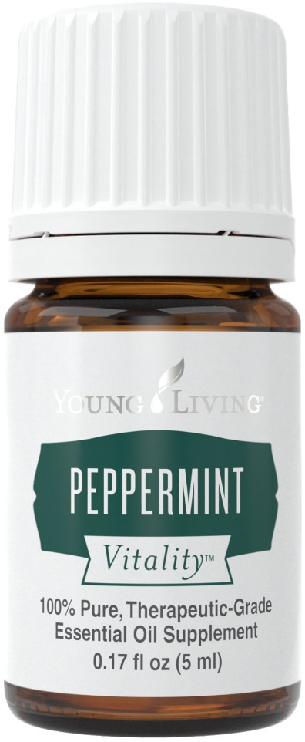
PEPPERMINT VITALITY
Supports gastrointestinal system comfort.*
Promotes healthy bowel function.*
Maintains efficiency of digestive tract.*
May support performance during exercise.*
*These statements have not been evaluated by the Food and Drug Administration. This product is not intended to diagnose, treat, cure, or prevent any disease.
Notes:
Next is Peppermint. [READ SLIDE]

Slide 25
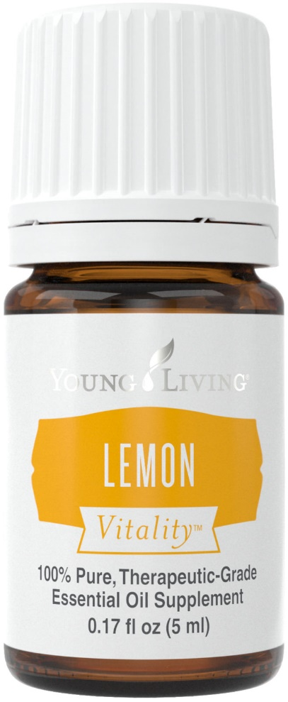
LEMON VITALITY
Includes the naturally occurring constituent limonene.
Enhances the flavor of foods and water.
Is a key ingredient in NingXia Red, Thieves, and Inner Defense.
Notes:
Lemon is next. [READ SLIDE]

Slide 26
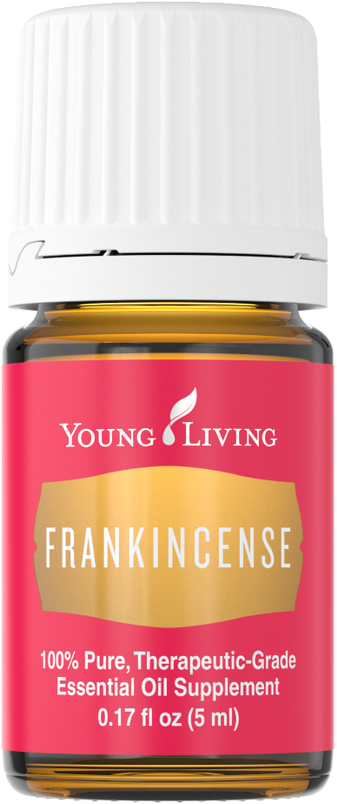
FRANKINCENSE
Has an earthy, balsamic scent.
Diffuse during meditation for grounding and purpose.
Use for massage after activity.
Is a key ingredient in Young Living personal care products.
Notes:
On to the next oil, Frankincense. [READ SLIDE]
In addition to all these uses, Frankincense may also help smooth the appearance of healthy-looking skin. It includes the naturally occurring constituent alpha-pinene and is a key ingredient in many products, including Boswellia Wrinkle Cream, Brain Power, Awaken, Highest Potential, and Forgiveness—favorite products for many members.

Slide 27
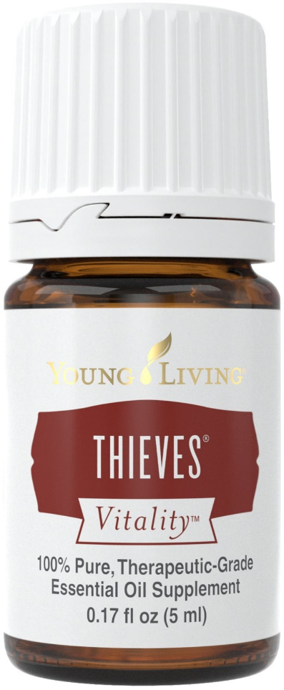
THIEVES® VITALITY
Supports healthy immune function.*
May contribute to overall wellness when taken as a dietary supplement.*
Includes Eucalyptus Radiata, which may help maintain a healthy respiratory system when taken as a dietary supplement.*
*These statements have not been evaluated by the Food and Drug Administration. This product is not intended to diagnose, treat, cure, or prevent any disease.
Notes:
Thieves is a blend of Lemon, Cinnamon, Clove, Rosemary, and Eucalyptus Radiata. Many people love Thieves because: [READ SLIDE]
There are so many ways to use Thieves:
Add to food or beverages to enhance their flavor.
Add a drop to hot drinks to add a spicy zing. (Clove, Lemon, Cinnamon, Rosemary)
Includes Clove, which was used traditionally as a spice for flavoring food.
Use 1 drop Thieves and 2 drops Orange as a refreshing flavor to complement your favorite beverage.
Add 1 drop to a cup of warm water as part of a wellness regimen.
Thieves contains oils that have been extensively researched:
Includes the naturally occurring constituent limonene. (Lemon, Eucalyptus Radiata, Rosemary)
Includes the naturally occurring constituent eugenol. (Clove, Cinnamon)
Includes the naturally occurring constituent eucalyptol. (Eucalyptus Radiata, Rosemary)

Slide 28
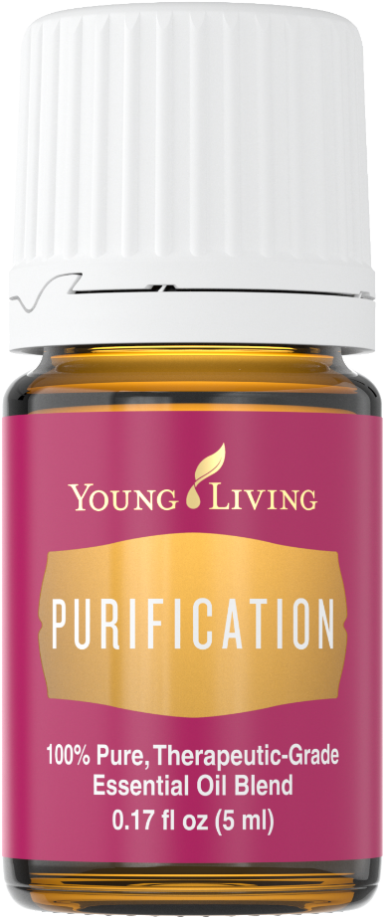
PURIFICATION®
Freshen air and eliminate odors.
Enjoy the outdoors annoyance free.
Add to Animal Scents Ointment to moisturize skin.
Enjoy cineol, neral, and geraniol.
Notes:
Purification is a blend of Citronella, Lemongrass, Rosemary, Melaleuca Alternifolia, Lavandin, and Myrtle. It’s a very versatile blend that can be used to: [READ SLIDE]
You can also use Purification by:
Adding to Young Living Bath & Shower Gel Base
Adding 4 drops to a cup of Epsom salt for a soothing foot soak
Adding to distilled water in a spray bottle to use when traveling to freshen the air

Slide 29
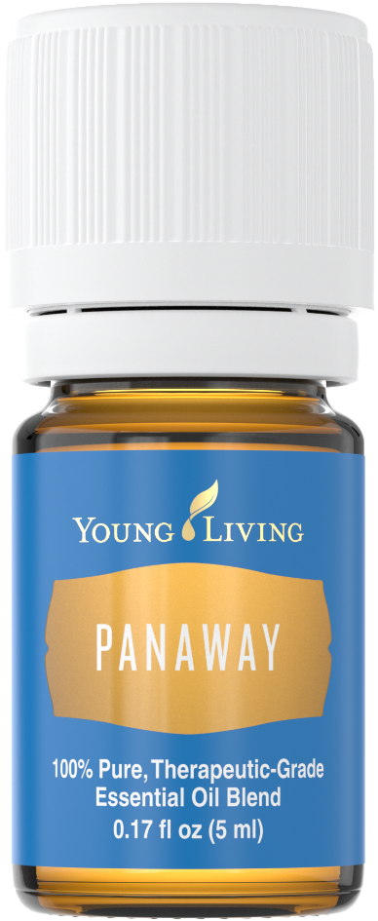
PANAWAY®
Apply topically after exercise.
Has a stimulating aroma.
Add to V-6 Vegetable Oil Complex and apply for soothing aromatic experience.
Notes:
PanAway combines Peppermint, Wintergreen, Clove, and Helichrysum and is one of our best-selling blends. [READ SLIDE]
It also includes the naturally occurring constituents methyl salicylate, gamma-curcumene, menthol, and eugenol.

Slide 30
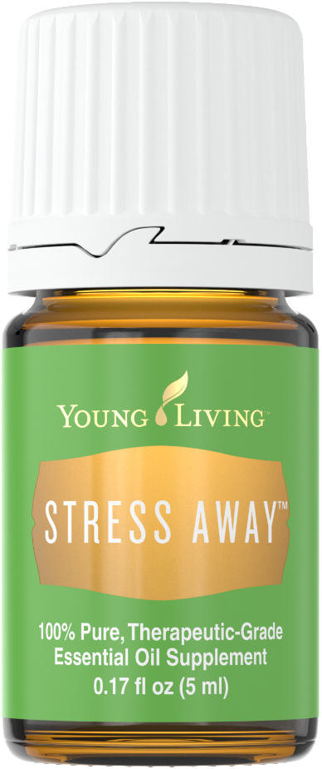
STRESS AWAY™
Promotes wellness.
Combines Lime, Vanilla, Copaiba, Lavender, Ocotea, and Cedarwood essential oils.
May be an important part of a daily health regimen.
Notes:
Stress Away is a great-smelling blend that: [READ SLIDE]
It also includes the naturally occurring constituents beta-caryophyllene, alpha-humulene, limonene, cedrol, and linalool.

Slide 31
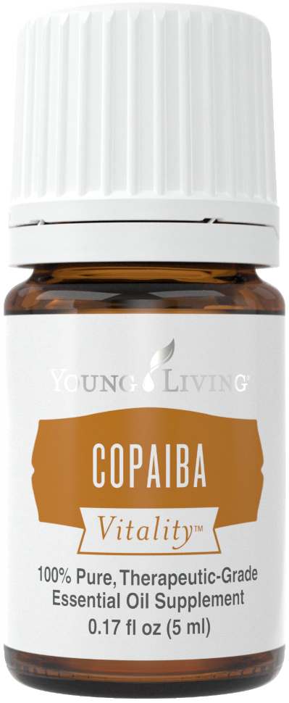
COPAIBA VITALITY
Promotes wellness.*
May be an important part of a daily health regimen.*
Includes the naturally occurring constituents beta-carophyllene and alpha-humulene.
*These statements have not been evaluated by the Food and Drug Administration. This product is not intended to diagnose, treat, cure, or prevent any disease.
Notes:
Next is Copaiba. [READ SLIDE]
Copaiba is also great for mixing with honey and warm water to create a tea.
[TIP: Copaiba is pronounced KOH-PIE-EE-BA.]

Slide 32
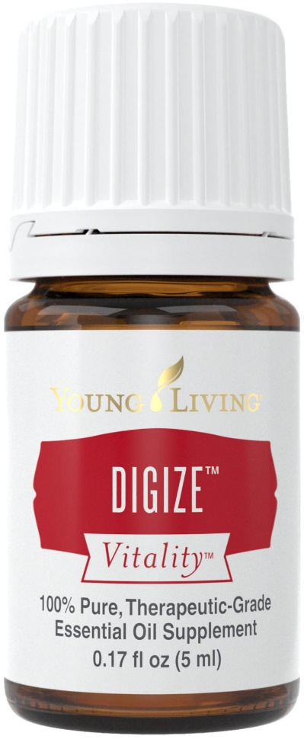
DIGIZE™ VITALITY
Can be taken with Essentialzymes-4 to support a wellness regimen.
Contains fennel, the use of which dates back to ancient Egypt.
Perfect as a dietary supplement in water when traveling abroad.
Notes:
DiGize contains Tarragon, Juniper, Anise, Ginger, Fennel, Patchouli, Peppermint, and Lemongrass essential oils. [READ SLIDE]
DiGize can be used in a variety of ways:
1. Add to a gel capsule.
2. Add 2 drops DiGize and 1 drop Peppermint to water for a stimulating beverage.
6. Add 2­–3 drops to honey for a tasty snack.
7. Includes the naturally occurring constituents of menthol, citrol, and zingiberene.

Slide 33
R.C.™
Rub on feet or chest before exercising to uplift and inspire.
Diffuse to create a comforting aroma.
Rub 3 drops on feet before bedtime.
Notes:
R.C. is a blend of three types of Eucalyptus, plus Myrtle, Marjoram, Pine, Lavender, Cypress, Black Spruce, and Peppermint essential oils. It includes the naturally occurring compounds linalool acetate, linalool, camphene, and eucalyptol, and it can can be used to: [READ SLIDE]

Slide 34
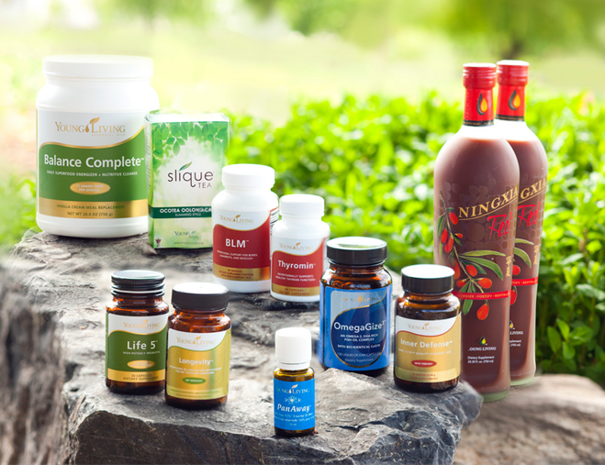
OIL-INFUSED PRODUCTS
Healthy & Fit
At Home
Personal Care
Notes:
Young Living also offers different product categories that can enhance any aspect of your life.
Wellness is multidimensional. Young Living is proud to have spent the last 20 years and counting developing a product line that cultivates wellness by purifying the home, nourishing the body, beautifying the skin and hair, and comforting the spirit—all while never compromising on our stringent Seed to Seal standards.

Slide 35
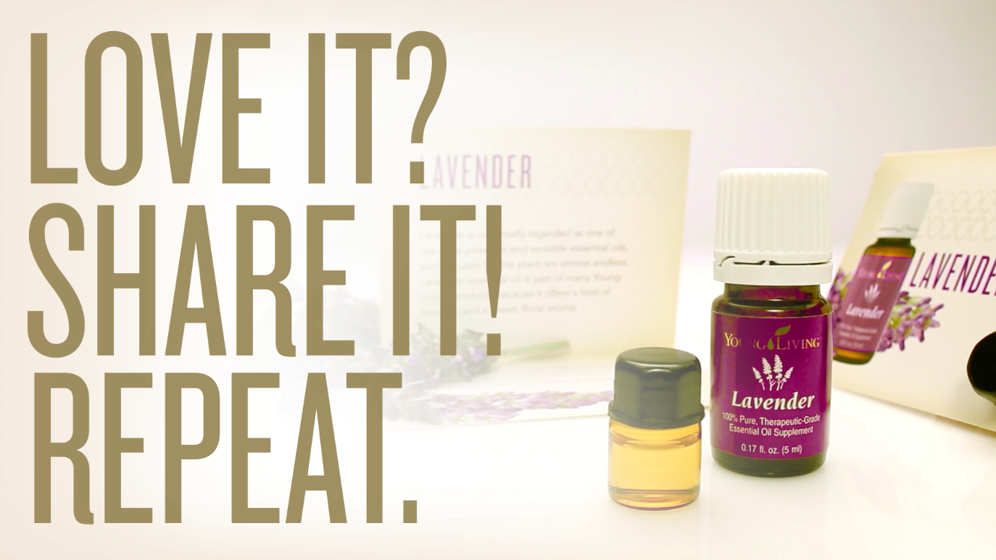
Notes:
When you join Young Living, you join a supportive global community of individuals who are passionate about authentic solutions for themselves and their families. A Young Living membership is much more than access to pure essential oils and essential oil-infused products. It allows you to maintain your optimal health, as well as help others around you do the same.
Knowing that your future and your family are well cared for is the final dimension of wellness. If you have always wanted greater financial independence and wanted to accomplish it doing something you can feel great about, sharing Young Living can help you find the missing piece in your wellness puzzle. It’s so simple! If you love Young Living, share it!

Slide 36
BECOME A YL MEMBER
Generous Compensation
Wholesale Pricing
24% off retail pricing
Essential Rewards
Exclusive Experiences
Community
Education
Recognition
Notes:
Are you ready to become a member? Some of the unique benefits of Young Living membership include:
Generous Compensation: Young Living offers an industry-leading compensation plan with generous commissions and bonuses.
Wholesale Pricing: You can save 24 percent off retail pricing on Young Living products. You can also save even more money with exclusive specials and promotions every month.
Essential Rewards: As a member, you are eligible to enroll in the Essential Rewards program and earn as much as 20 percent back from each order in Essential Rewards points. These points can be used like cash on some of your favorite products.
Exclusive Experiences: No other essential oil company will give you the opportunity to participate in unique events, such as the Global Leadership Cruise and our annual International Grand Convention, and to experience our Seed to Seal process firsthand at farm harvests and plantings.
Community: Enjoy a close-knit community of support. In addition to your sponsor, the entire Young Living family is ready to assist and encourage you in your journey.
Education: Young Living provides ongoing educational opportunities through conventions, events, and newsletters to keep you informed and assist you in your wellness progress.
Recognition: As you expand your organization and advance toward the prestigious rank of Royal Crown Diamond, you will enjoy special recognition for your accomplishments and leadership!

Slide 37
ESSENTIAL REWARDS PROGRAM
1–3 months
4–24 months
20% of order PV
25+ months
25% of order PV
10% of order PV
Easy monthly shipments
Discounted shipping
Exclusive bonuses
Essential Rewards points—earn free product credits!
Notes:
You may also want to consider joining the Essential Rewards program. Essential Rewards gives you 10-20 percent back in free products when you sign up to place an order every month. Earn points toward future product purchases with every Essential Rewards order. As your months with Essential Rewards increase, so do your rewards! [READ SLIDE]

Slide 38
YOUR LIFE. YOUR HEALTH. BE EMPOWERED.
Notes:
Your life can change at Young Living, and you can be empowered through wellness, purpose, and abundance. My life has been enhanced through my experiences with Young Living. [Share one of your favorite experiences.]
The best thing about Young Living is that the meeting I just conducted is ready for you to share, too. The slides, script, and content is right at your fingertips!
I am happy to answer any of your questions and help you get enrolled as a member and started on your Young Living journey!

